Slide 1
Backups and Restoring Data
with tar
Cybersecurity
Lesson 5.1

Slide 2

Learning Objectives
By the end of today’s class, you will be able to:
Identify and describe use cases for the three kinds of backups.
Create (tar) an archive from existing files and directories.
List and search the contents of an existing archive.
Extract (untar) the contents of an archive.
Describe and demonstrate two exploits for the tar command.
6
Identify and describe how backups are used for compliance.

Slide 4




Archiving and Logging Data
Linux tools used by System Administrators
01
02
03
Archiving Data
Scheduling Backups
Monitoring Log Files

Slide 5


Archiving and Logging Data
These skills are used by system administrators to accomplish the following tasks:
1
Overseeing or conducting data backup and recovery.
2
Determining how long to retain data and
the frequency of backups.
3
Monitoring and troubleshooting backups and restoration.
4
Providing security for compliance
requirements.

Slide 6

Archiving with tar

Slide 7

Archives and Backups
Promoting data availability
Backups and data archiving are important to maintain compliance.
Regulations governing IT security industries such as:
Finance
Health

Slide 8
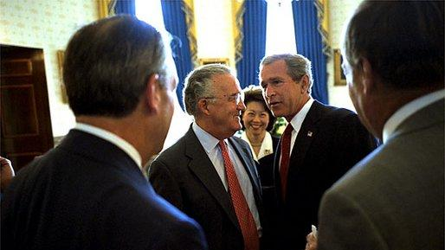

Finance
Before the signing ceremony of the Sarbanes–Oxley Act, US President George W. Bush meets with Senator Paul Sarbanes, Secretary of Labor Elaine Chao, and other dignitaries in the
Blue Room at the White House on July 30, 2002.
In finance, the common standard for data archiving is the Sarbanes–Oxley Act (SOX).
It requires all business records and communication to be retained for five years.
Notes:
Image source: public domain

Slide 9







Finance
Markets in Financial Instruments Directive (MiFID II)
Markets in Financial Instruments Directive (MiFID II) requires the European Union's financial firms to retain and reproduce records of all activity from:
Telephone Conversations
Electronic Communications
  Instant Messaging
  Social Media Interactions

Slide 10


Health
Health Insurance Portability and Accountability Act (HIPAA)
Health Insurance Portability and Accountability Act (HIPAA) requires healthcare providers to keep records for six years.

Slide 11
Most businesses and government agencies have specific retention requirements that must be maintained.

Slide 12

Creating and Restoring
Backups with tar

Slide 13

Cyber professionals
must ensure that data is always protected against threats of data loss and interruptions caused
by cyberattacks or natural disasters.
Notes:
shutterstock_778654396

Slide 14


Ensuring Availability of Data
Ransomware
As of July 2023, ransomware payments exceeded $500 million.
Natural Disasters
In 2019, Hurricane Michael caused massive flooding, destroying hundreds of homes, businesses, and strategic defense data.

Slide 15
A backup is a saved version of specific files in a drive or network folder at a given point in time.

Slide 16

Backing Up Data
System administrators backup data so organizations can quickly recover lost assets and restore systems.
1
A backup saves specified files on your system and copies them to a safe secondary place.
2
Backups are generally completed hourly or daily.
3
Performing regular backups is a top
priority for organizations.

Slide 17
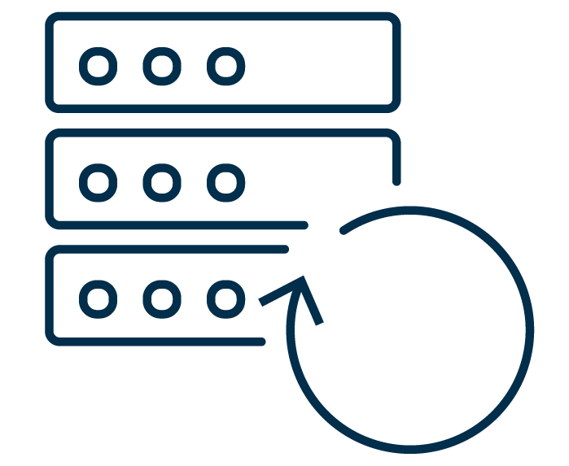
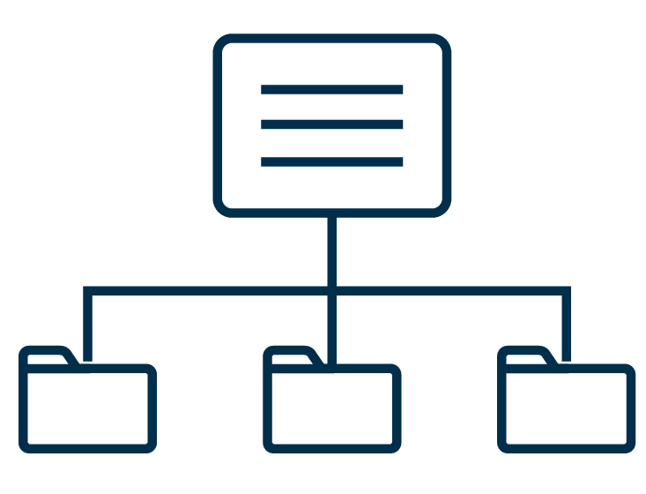

Creating and Restoring Backups
Different Types of Backups
Full Backup
Differential Backup
Incremental Backup
More reliable and offers complete restoration but requires large storage space
Captures all of the changes made since that initial backup
Captures only the changes made since the last backup, whether it was a full, differential, or incremental backup

Slide 18
The tar (tape archive) command is a Linux utility that system administrators use to create a backup.

Slide 19
An archive is a special file that contains a concatenation of files and directories.

Slide 20



Performing a backup
Ability to “rewind” time
tar takes files we want to backup and creates an archive of them.
Archives created with tar are called tarballs, and use the .tar extension.
tar backups take up the same amount of space as all the files on the drive.

Slide 21

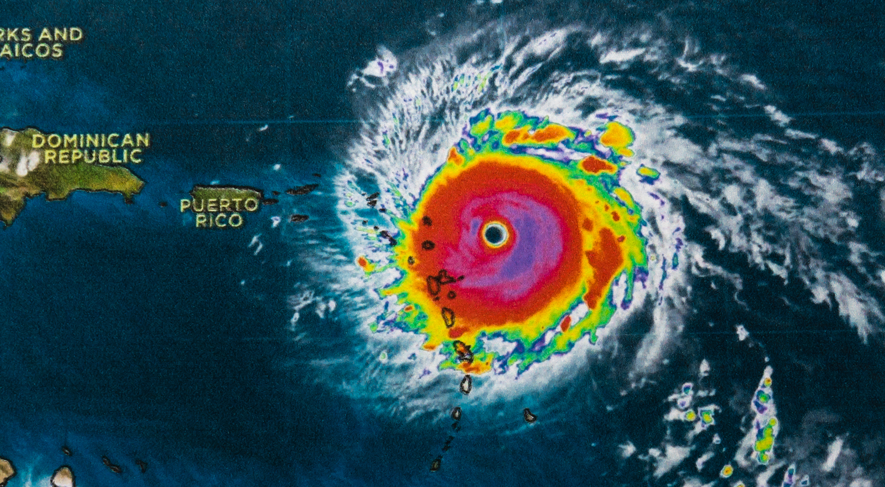
Scenario
Let’s apply this command to the following scenario:
The systems operations center at Tyndall Air Force Base is backing up all system data with the approaching threat of Hurricane Michael.
Notes:
shutterstock_1888488028

Slide 22
Creating an Archive
Syntax options for tar
Basic syntax of the tar command
tar [option(s)] [archive_name] [objects_to_archive]
Notes:
tar [option(s)] [archive_name] [objects_to_archive]

Slide 23
Creating an Archive
Create a full backup of all logs in /var/log
sudo tar [option(s)] [archive_name] [objects_to_archive]
sudo is required because the files in /var/log are system files, so we’ll need administrator rights to create a backup.
Notes:
tar [option(s)] [archive_name] [objects_to_archive]

Slide 24
Creating an Archive
Create a full backup of all logs in /var/log
sudo tar [option(s)] [archive_name] [objects_to_archive]
tar is the Linux command to create the backup.
Notes:
tar [option(s)] [archive_name] [objects_to_archive]

Slide 25
Creating an Archive
Create a full backup of all logs in /var/log
sudo tar cvf [archive_name] [objects_to_archive]
These are short form options:
c stands for create
v stands for verbose
f indicates the title of the archive
Notes:
tar [option(s)] [archive_name] [objects_to_archive]

Slide 26
Creating an Archive
Create a full backup of all logs in /var/log
sudo tar cvf 2018-10-12-hurricane-backup.tar [objects_to_archive]
2018-10-12-hurricane-backup.tar is the name we are assigning to our new archive.
Notes:
tar [option(s)] [archive_name] [objects_to_archive]

Slide 27
Creating an Archive
Create a full backup of all logs in /var/log
sudo tar cvf 2018-10-12-hurricane-backup.tar /var/log
/var/log are the objects that we want to archive.
Notes:
tar [option(s)] [archive_name] [objects_to_archive]

Slide 28
Running the tar command

Slide 29
gzip is a command used to create a compressed tar archive, indicated with a tar.gz extension.

Slide 30
Compressing Archives with gzip
gzip compression is useful when disk space is an issue
Moving files requires less bandwidth, faster transfer times
Compress the archive
gzip 2018-10-12-hurricane-backup.tar
Extract a compressed archive
gunzip 2018-10-12-hurricane-backup.tar.gz

Slide 31
Compressing Archives with gzip
Compress & Decompress with tar
sudo tar czvf 2018-10-12-hurricane-backup.tar.gz /var/log
-cz creates the file and compresses it using gzip.
sudo tar xzvf 2018-10-12-hurricane-backup.tar.gz /var/log
-xz extracts the file and decompresses it using gzip.
Notes:
tar [option(s)] [archive_name] [objects_to_archive]

Slide 32

Archiving Best Practices
Maintaining security, privacy, and integrity
Be sure archives are not writable by an untrusted user.
Inspect all data, such as passwords, before writing to an archive, since this data will be copied to the archive.
Pay attention to the diagnostic and exit status of tar.

Slide 33

Demonstration Scenario
Creating archives to protect organizations
In 2019, Hackensack Meridian Health systems were compromised by a ransomware attack. Attackers encrypted medical data of many patients in the hospital.
The attackers offered to decrypt the data in exchange for payment, effectively ransoming the government's data. Unfortunately, in the case of Hackensack, the hospital had to pay.
Notes:
shutterstock_1888488028

Slide 34
Demonstration Scenario
Creating archives to protect organizations
Affected systems impacted:
Doctors
Patients
Treatments
After taking the infected systems offline, we’ll need to:
Restore the operating system and applications using the full backup.
Restore email data using the full backup.
Restoring the email data will require using the tar command to:
List the contents of the latest full backup to locate the email data.
Extract the email data from the archive to a directory on the new system.
Notes:
shutterstock_1888488028

Slide 35
Medical Center

Slide 36
Creating and Restoring Backups with tar
In this activity, you are a junior administrator at Rezifp Pharma Inc. In recent weeks, there have been a series of malware attacks and now the company is strengthening its backup activities.
In response to the malware attacks, your department has decided to create daily full backups of the files associated with the E-Prescription Treatment database that contain (PII).
A pharmacy technician notices that some files in the Patient database are missing and the team discovers that the wrong full backup was used.
20 Minutes

Slide 39
Restoring Data with Incremental Backups

Slide 40

The file sizes for full backups are very large, because they include everything on a system.
Depending on the size of the file system, doing a full backup takes a very long time.
Notes:
Image source: shutterstock_1043622175

Slide 41

Incremental Backup
Incremental backups are completed after a full backup is performed on a system, only capturing what has changed since the last incremental backup.
1
Incremental backups store a list of which files have changed in a snapshot file, with the extension .snar.
2
The snapshot is created when the admin creates the initial level-0 backup.
3
Every time an incremental backup completes, a new snapshot is created that contains only files that have changed since the last full or incremental backup.

Slide 42
Incremental Backups
Incremental backups drawbacks:
Restoration
Loss of Data
Additional Verification
Restoring the backup is slow, as you must restore the latest full backup plus all the previous incremental backups.
Loss of data possible if a single backup is corrupted.
Verify an archive was created with no error using tar W.

Slide 43

Creating the Incremental Backup
Incremental backups are a form of tar archive
tar stores additional metadata and information
Tracks modified and deleted files since the last backup
Incremental backup will only contain modified files
Stored in a snapshot file .snar

Slide 44
Creating an Incremental Backup
Syntax options for incremental backups with tar
tar cvvWf emerg_back_sun.tar --listed-incremental=emerg_backup.snar --level=0 emergency
--listed-incremental=emerg_backup.snar tells tar that the backup will be part of a series of incremental backups, and stores metadata about the backup in a snapshot file emerg_backup.snar.
Notes:
tar [option(s)] [archive_name] [objects_to_archive]

Slide 45
Creating an Incremental Backup
Syntax options for incremental backups with tar
tar cvvWf emerg_back_sun.tar --listed-incremental=emerg_backup.snar --level=0 emergency
--level=0 tells tar that this is the first backup of the series.
Notes:
tar [option(s)] [archive_name] [objects_to_archive]

Slide 46
Incremental Backup Scenario
Sunday
A hospital’s system operations staff performs a full backup of all the data in the emergency database.
Tuesday
An incremental backup archives only the changes made on Tuesday to the emergency database.
Wednesday
The hospital is hit with a ransomware attack and all the data in the emergency database is encrypted.
Monday
The staff runs an incremental backup that stores all changes made on Monday. This backup is smaller than the full backup.
Notes:
shutterstock_1888488028

Slide 47

Fortunately, the hospital had created full and incremental backups and the files in the emergency database are easy
to restore.
Notes:
Image source: shutterstock_1213753120

Slide 48
Incremental Backup Scenario
01
Create a full backup of the emergency directory and a snapshot file.
02
Display the contents of the level 0 backup generated on Sunday.
03
Create the incremental backups generated on Monday and Tuesday.
04
Remove the emergency directory to mimic the ransomware attack on Wednesday.
05
Restore the emergency directory.
Notes:
shutterstock_1888488028

Slide 49
Incremental Backups

Slide 50
Restoring Data with Incremental Backups
In this activity, you will continue as a junior administrator at Rezifp Pharma Inc.
Your organization has just adopted a new backup policy and you are responsible for validating the new process.
In this simulation, you will perform two tests:
Restore patient files that were deleted during an attack on Sunday.
Create two new files and perform an incremental backup on Monday to ensure the new files were properly backed up.
20 Minutes

Slide 53
Incremental Backups

Slide 54

Exploiting the tar Command with the Checkpoint and Wildcard Options

Slide 55

Hackers can combine the tar command with the wildcard character (*) and the checkpoint feature to plant malware on a system.
Notes:
shutterstock_261034547

Slide 56
Using Wildcard with tar
Wildcards and Archives
We previously used wildcard characters * for creating archives.
* is used to indicate all files in a directory
For example:
Documents/ExploitTar contains multiple directories that we want to archive.
./* represents all the contents of Documents/ExploitTar
~$ ls Documents/ExploitTar
f1 f2 f3 f4 f5 f6 f7 f8 f9
~$ tar cvf archive.tar ./*

Slide 57
A checkpoint is an action assigned to take place at a specific stage of a backup or restoration.

Slide 58


Using Checkpoints
For example:
Once the backup reaches 1,000 files, a checkpoint triggers the backup to pause and display the amount of remaining disk space.
When restoring files from
a remote site, a message will
print the number of bytes transferred every 5,000 files.
The action taken and the frequency will vary based on
the circumstance.
01001101001001010100010001001010101010010101010101010100110100100101010001000100101010101001010101010101
1000

Slide 59
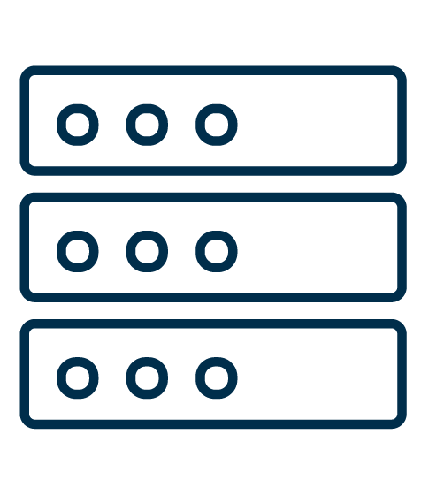

Using Checkpoints
Including checkpoints helps to avoid serious issues
Space Availability
Help avoid the accidental usage of all the freespace on a backup server.
Network Performance
Reduce the amount of data transferred over network at one time.

Slide 60

Using Checkpoints
Checkpoints involve two commands. The first defines the checkpoint, and the second specifies the action to be taken at that checkpoint:
--checkpoint=1000
--checkpoint-action=du
Indicates how often the
checkpoint occurs.
At every thousandth file, an
action will take place.
Syntax: --checkpoint=[n]
Indicates the action that will
take place.
du displays the available disk
space on the machine.
Syntax: checkpoint=[ACTION]

Slide 61



Exploiting System Vulnerabilities
Previously we discussed how sysadmins harden against exploits
Identify Weaknesses
Arbitrary Code Execution
tar checkpoints
Identify weak or vulnerable services
Exploit with open-source code or use their own
ACE
ACE is extremely dangerous
Attempt to gain root privileges
Known vulnerability
Plant malicious code on a system
Allows root privileges

Slide 62

Checkpoint + Wildcard Exploit
First, a hacker gains access to a system by impersonating a normal user:
Hacker
Compromised User
Elevated privileges,
access to sensitive data
Log in via
stolen password
Normal user can’t access sensitive files, open network connections, or perform root privilege actions

Slide 63
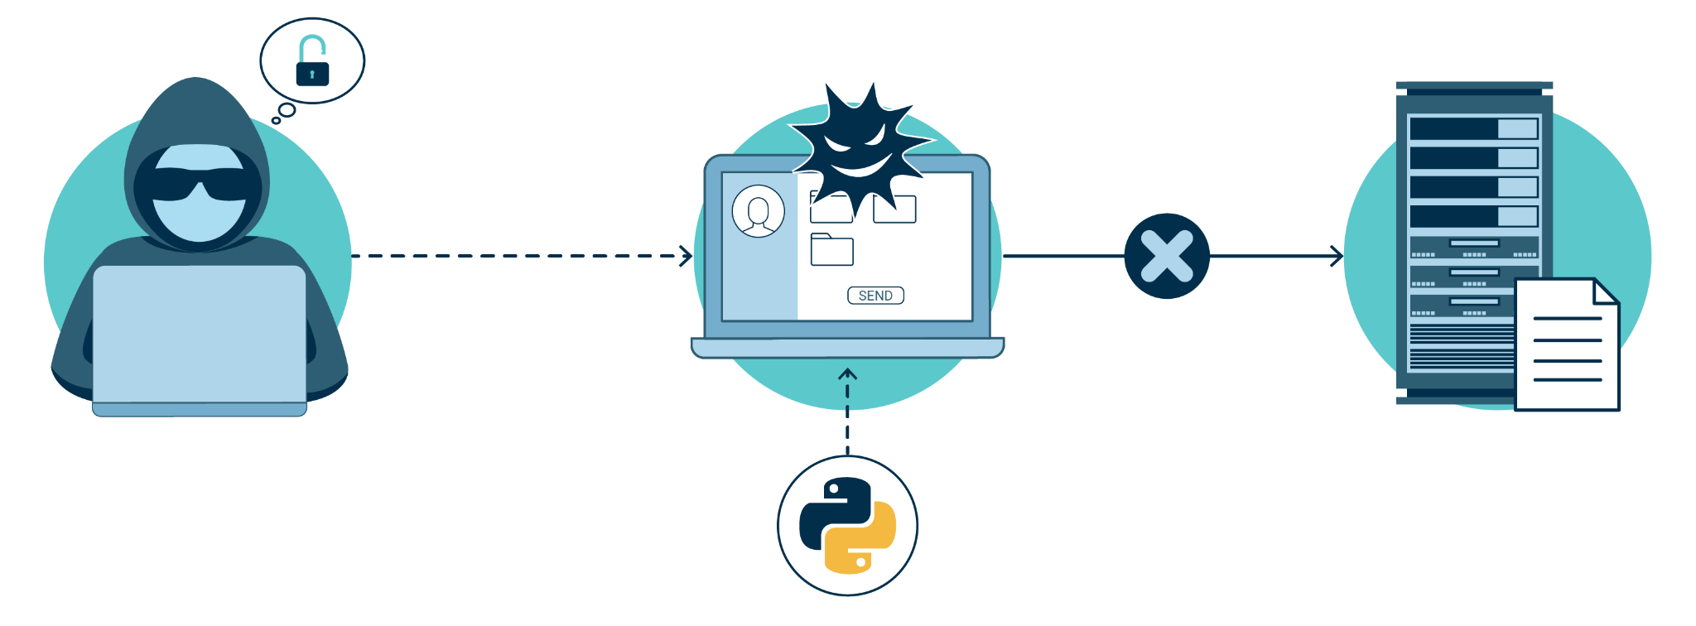
Checkpoint + Wildcard Exploit
A normal user can typically download and execute files from the internet. If a file is malicious, it can compromise the system.
Hacker
Compromised User
Elevated privileges,
access to sensitive data
Log in via
stolen password
Normal user can’t access sensitive files
Downloadable Python script, wildpwn.py, can exploit tar and gain root privileges.

Slide 64
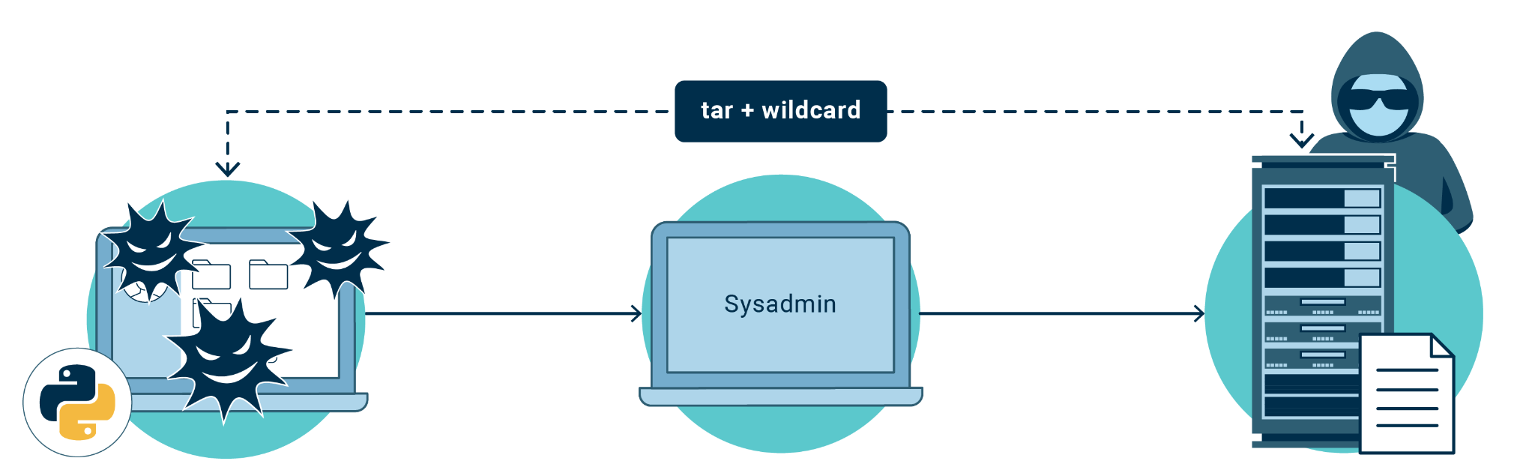
Checkpoint + Wildcard Exploit
Unsuspecting admins with root privileges run a tar command containing a wildcard. This will create an archive containing the directory of the malicious script.
wildpwn.py plants three malicious files on the machine: one hidden, and two files with names like tar checkpoint commands.
Sysadmin unknowingly creates an archive containing planted malicious script.
A hacker can drop into root shell, gaining full access to the system.

Slide 65
But how do checkpoints and wildcards fit into this exploit?

Slide 66

Checkpoint + Wildcard Exploit
Exploiting tar
-When an attacker runs wildpwn.py, it creates three files.
-The attacker can create these files with normal user privileges.
-Files include a malicious script (.webscript) and two files resembling checkpoint commands:
--checkpoint=1
--checkpoint-action=exec=sh .webscript
After adding the first file to archive, tar will execute .webscript.
Notes:
shutterstock_1888488028

Slide 67

Demonstration Scenario
Exploiting tar
An attacker has gained access to our system by stealing the password for the instructor user.
Although, for this example, we will pretend that instructor user does not have root access. In your activity, you will truly be working on a user without root access.
We will be taking the role of the attacker and will use wildpwn.py to plant malicious files. These files will be executed when an administrator with root privileges runs the tar command.
Notes:
shutterstock_1888488028

Slide 68
Exploiting tar

Slide 69
Exploiting the tar Command with the Checkpoint and Wildcard Options
In this exercise, you'll play the part of a penetration tester hunting for vulnerabilities in a target system's backup procedures.
You'll use the wildpwn.py tool to verify that the system's current configuration is indeed vulnerable to this kind of privilege escalation attack.
Then, you'll research and suggest two mitigation strategies to protect the server in the future.
25 Minutes

Slide 72

Recap
Backups and Restoring Data
01
Identified and described three types of backups
02
Created, listed, and searched archives
03
Extracted contents of an archive
04
Used exploits with the tar command

Slide 73
cron and Scheduled Jobs

